Slide 1
Noah’s Ark
Types and Antitypes

Slide 2

Genesis 6:1-7 types the Gospel Age, beginning in the second century with the first developments of the Greek Catholic Church and lasting until the beginning of the Great Tribulation.

Slide 3
Genesis 6:1
And it came to pass, when men
Men here type the twelve denominations of Christendom developed during the Gospel Age.
began to multiply on the face of the earth,
History tells us that these denominations greatly increased in society (earth). Some as antichrists, the rest as false prophets, but all were symbolic men.
and daughters were born unto them,
They developed by their principles the governments of Christendom or the so-called Christian states (daughters).

Slide 4
Genesis 6:2
That the sons of God saw the daughters of men that they were fair;
The impenitent fallen angels (sons of God) became attracted to these governments.
and they took them wives of all which they chose.
They then selectively united themselves to them that were favorable for the reasons of carrying out their selfish purposes.

Slide 5
Genesis 6:3
And the LORD said
Due to the wickedness, which resulted especially from the union of state and church, Jehovah declared, starting with Spener in 1691 and progressing through the Parousia movement, that He would not continue to give, through his teaching, instruction to these churches,
My spirit shall not always strive with man,
for that he also is flesh:
due to their corruption.
yet his days shall be an hundred and twenty years.
He also declared that the punishment of Christendom's church and government systems would be delayed until the last crown-retainer and crown-loser would come into existence.
The Little Flock and the Great Company, came into existence by Sept. 16, 1914 ([120 = 12 x 10] 12—the full number of the Little Flock and 10 the full number of the Great Company). And then the antitype of the Flood began.

Slide 6
Genesis 6:4
There were giants in the earth
Capitalistic and labor trusts (giants) were born everywhere in Christendom's society (in the earth),
in those days;
especially since the beginning of the Time of the End, 1799 (in those days).
and also after that, when the sons of God
This was the result of the impenitent fallen angels
came in unto the daughters of men,
uniting with governments of Christendom
and they bare children to them, the same became mighty men which were of old, men of renown.
These trusts certainly became powerful (mighty) and famous (renown).

Slide 7
Genesis 6:5
And GOD saw that the wickedness of man was great in the earth,
Jehovah took note of the great wickedness of the church systems throughout society.
and that every imagination of the thoughts of his heart was only evil continually.
Every invention of their loved creed articles was always error.

Slide 8
Genesis 6:6
And it repented the LORD that he had made man on the earth,
There wickedness and errors caused God to change His procedure from that whereby He placed the church the church systems in society.
and it grieved him at his heart.
The church systems' evils greatly displeased God.

Slide 9
Genesis 6:7
And the LORD said, I will destroy man whom I have created from the face of the earth; both man,
God declared from 1691 - 1916 starting with Spener and progressing through the Parousia movement, which were His mouthpieces, that He would overthrow the church and state systems which He had made and placed in society.
and beast,
He would also destroy the non-Christian religions,
and the creeping thing,
the depraved individuals
and the fowls of the air;
and false teachers.
for it repenteth me that I have made them.
He would no longer put them into the form of society as it has existed in the second symbolic earth.

Slide 10
The time before the Flood, covered by Gen. 6:8-22, types the entire Gospel Age from its beginning to its end;

Slide 11
Genesis 6:8
But Noah found grace in the eyes of the LORD.
God found favor in Jesus (the antitypical Noah) and in all in harmony with Him.
Genesis 6:9
These are the generations of Noah:
Now are to be set forth the experiences (generations [toledoth, histories, or experiences] of Jesus (Noah).
Noah was a just man and perfect in his generations,
Jesus is the Righteous and perfectly sinless one in all His experiences;
and Noah walked with God.
and He was in perfect harmony and fellowship with God.

Slide 12
Genesis 6:10
And Noah begat three sons, Shem, Ham, and Japheth.
Our Lord fathered the Great Company in three groups (Noah [comfort] begat [literally, brought to birth] Shem [fame], Ham [swarthy] and Japheth [extension]

Slide 13
Genesis 6:11
The earth also was corrupt
Earth’s society in church, state, capital and labor in Christendom, particularly in the Time of the End, from 1799 until the end of the Epiphany period, and most particularly from 1874 onward, has been very corrupt,
before God,
especially in matters pertaining to God.
and the earth was filled with violence.
Violence of all kinds increased in Christendom's church, state, capital and labor, e.g., in the sectarian controversies and persecutions, in the governments' internal controversies and revolutions and in their external controversies and wars, in capital's financial internal and external battles and in labor's internal and external strifes, strikes, riots, etc.

Slide 14
Genesis 6:12
And God looked upon the earth, and, behold, it was corrupt;
God took special note of these social conditions,
for all flesh had corrupted his way upon the earth.
capitalist and labor systems had depraved their teachings and practices in society.

Slide 15
Genesis 6:13
And God said unto Noah, The end of all flesh is come before me;
God brought this evil to Jesus' attention and forecast their end to Him,
for the earth is filled with violence through them;
giving as His reason that society was very lawless against right and order.
and, behold, I will destroy them with the earth.
Also God gives His intention to destroy entirely these institutions, together with society.

Slide 16
Genesis 6:14
Make thee an ark of gopher wood;
When Jesus was about to consecrate Himself, He received the beginning of the charge to build the antitypical Ark.
Its building required Him (a) to consecrate His humanity and to receive the Spirit-begettal [gopher wood is an evergreen tree, symbolic of the everlasting life to which His perfect humanity is entitled] and (b) to receive the Spirit-quickening, Spirit-growth, Spirit-strengthening, Spirit-balancing, Spirit-crystallizing and Spirit-birth.
Some of these seven things were exclusively God's work on Him, i.e., Spirit-begettal and Spirit-birth; the others were a combined work of God and Christ. Hence the correctness of the charge, "Make thee an ark."
rooms shalt thou make in the ark,
Christ was to engage in various spheres of work, in order to extend saving powers toward all classes.
and shalt pitch it within and without with pitch.
His true disciples would have to be curse-proof. Also, Christ was to have in Himself all of the class Divine and all saved classes of lower natures.

Slide 17
Genesis 6:15
And this is the fashion which thou shalt make it of: The length of the ark shall be three hundred cubits, the breadth of it fifty cubits, and the height of it thirty cubits.
300 . . . 50 . . . 30 cubits.
300 + 50 + 30 = 380;
380 ÷ 10 (natures lower than Divine nature) = 38.
38 ÷ 2 (the Divine class consists of two parts, Jesus, the Head, and the Church, His Body) = 19.
19 = 7 (Divine) + 12 (the totality of the Little Flock).

Slide 18
Genesis 6:16
A window shalt thou make to the ark,
God's Word and Spirit would be the respective means through which Jesus would cause the Truth and its Spirit to come to Him and to all the saved in Him [zohar, the Hebrew word used here for window means light].
and in a cubit shalt thou finish it above;
The Word and Spirit were to be perfect for the needs of all in the antitypical Ark and to shut out the elements of the curse [literally, there should be a porch-like structure built above the window, which extended along the entire perimeter of the ark].
and the door of the ark shalt thou set in the side thereof;
Jesus as Teacher, Justifier, Sanctifier and Deliverer is the means of coming into Him as the antitypical Ark.

Slide 19
Genesis 6:16
A window shalt thou make to the ark, and in a cubit shalt thou finish it above; and the door of the ark shalt thou set in the side thereof;
and with lower, second, and third stories shalt thou make it.
Three saved elect classes would come into Him during the Gospel Age:
The Youthful Worthies as unlapsed tentatively justified ones (lower).
The Great Company (second).
The Little Flock (third stories shalt thou make it [all three of these elect classes would be Gospel-Age consecrated].

Slide 20
Genesis 6:17
And, behold, I, even I, do bring a flood of waters upon the earth,
Jehovah gives as the reason for making “Christ the Ark”, the curse—in general feature from Adam's day onward and in its concluding feature, the Time of Trouble.
to destroy
Both parts of the curse are destructive;
all flesh,
the general curse destroys, in the Adamic death, all who do not come into Christ; and its special feature, its climax, destroys all church, government, capital and labor systems
wherein is the breath of life,
wherein is the energetic power to do evil [literally, lives],
from under heaven;
that thus the new heavens would be over none of such.
and every thing that is in the earth shall die.
God's determination is to destroy all such in the curse.

Slide 21
Genesis 6:18
But with thee will I establish my covenant;
God confirmed to Jesus His Oath-bound Covenant.
and thou shalt come into the ark,
Jesus by the earlier-mentioned seven steps was to come into the condition of being the antitypical Ark and:
thou, and thy sons,
The Great Company in three groups.
and thy wife,
The Little Flock.
and thy sons' wives
The Youthful Worthies in three groups.
with thee.
All as the saved by Jesus, would enter the antitypical Ark.

Slide 22
Genesis 6:19
And of every living thing of all flesh, two of every sort shalt thou bring into the ark, to keep them alive with thee;
Additionally, two general classes, Abrahamic and Mosaic Covenants.
Believing and justice-practicing Jews and the unconsecrated but Ransom-believing and justice-practicing faith-justified, both as quasi-elect classes.
Unbelieving Jews and Gentiles as the non-elect classes, were to be brought into Christ as the antitypical Ark in an anticipatory sense, seeing that His Ransom-price will be made available for them Millennially,
they shall be male
both the leaders
and female.
and the led among them (two of every sort).

Slide 23
Genesis 6:20
Of fowls after their kind,
Among them are to be those who have been the leaders or the led of the various religions.
and of cattle after their kind,
The leaders and the led in secular matters.
of every creeping thing of the earth after his kind,
The leaders and the led of even the most backward and depraved heathen.
two of every sort shall come unto thee, to keep them alive.
They were as leaders and the led to be brought into Christ as explained in the preceding sentence, for their preservation.

Slide 24
Genesis 6:21
And take thou unto thee of all food that is eaten,
Jehovah charged Jesus to take with Himself every part of the Word as food
and thou shalt gather it to thee; and it shall be for food for thee, and for them.
variously collected as to the parts adapted to the needs and uses of Himself, the four elect classes, the two general quasi-elect classes and the non-elect classes.
Genesis 6:22
Thus did Noah; according to all that God commanded him, so did he.
As charged by the Father, our Lord did everything as to the building of the antitypical Ark, its passengers and their food.

Slide 25
The Flood year covered by Gen. 7:12 - 8:14, types certain events which occurred from the time of the Abrahamic Covenant April 2045 till close of the general call in October 1881. A period of 3929.5 years.

Slide 26
Summary Of The Ark Type
It will be remembered that our dear Pastor Russell explained the Ark as typing "Christ and the power in Him which will replenish and reorganize Society”. P1 page 318
Our dear Brother Johnson explained that Christ and that replenishing and reorganizing power are summarized in the Abrahamic Covenant, which we all know was made in April 2045 B.C.
Therefore, it would be in harmony with our Pastor's Russell’s definition of the Ark's antitype as the Abrahamic Covenant, the embodiment of God's counsel.

Slide 27
Those Who Were Saved In The Ark (Abrahamic Covenant).
Noah types Jesus.
His Wife types the elect Church.
Shem and his Wife type the Ancient Worthies, the leaders and the led.
Japhet and his Wife type the Great Company, the leaders and the led.
Ham and his Wife type the Youthful Worthies, the leaders and the led.
The clean animals type the believing Jews who will be saved, and those persistently tentatively justified who will be saved (ten groups of the Quasi Elect).
And the unclean animals represent those out of the unclean world that will be save during the millennial reign of Christ.

Slide 28
The flood lasted one year or 365 days.
The antitypical period typed by the flood year started April 2045 BC with God making the covenant with Abraham and ended October 1881 at the end of the general call.
The total number of years typed are 3925.5
3925.5 ÷ 365 = 10.7547945 years per typical flood day.
The pertinent events described always occur within 10.7547945 years before the antitypical year that is mentioned.

Slide 29
 | Days | Years | Date
 |  |  | April 2045, B.C. | Start of the Abrahamic Covenant
Gen. 7: 12 40 days of rain. | 40 | 430.19178080+ | July 1615, B.C. | Law Covenant was made with Israel April 1615 B.C.
Gen. 8: 4 The ark rested on mount Ararat. | 107 | 1150.76301364+ | April 464, B.C. | Persian King Artaxerxes commissioned Ezra to return to Jerusalem with all Israelites such minded (Ez. 7: 1-28) and also provided for their help especially along religious lines in 468 B.C.
Gen. 8: 3 Waters begin to subside. | 3 | 32.26438356+ | July 432, B.C. | Nehemiah finished the first twelve years of his reformatory and defensive work for Israel in Oct. 433 B.C. (Neh. 13: 6-31).

Slide 30
 | Days | Years | Date
Gen. 8: 5 The tops of the mountains were seen. | 70 | 752.83561640+ | May 322, A.D. | Constantine made his various edicts of religious toleration, which gave both true and counterfeit Christians religious freedom ending Pagan Rome's persecutions in 313 A.D. and in 318 A.D. Arius began fruitful work for the truth.
Gen. 8: 6 Noah sent forth a dove and a raven. The dove returned but the raven did not. | 40 | 430.19178080+ | July 752, A.D. | Sectarianism (Raven) through Boniface, as the Pope Zacharias’s representative, sought to subject all converted Germany & France to the Pope. An anti-Romanizing movement (Dove) led by a frank named Adalbert, Scotchman named Clement, and by an Irishman named Virgilius opposed Papal ideas from A.D. 741-752.

Slide 31
 | Days | Years | Date
Gen. 8: 10 Noah sent for the same dove and it returned with an olive leaf. | 7 | 75.28356164+ | Oct. 827, A.D. | Claudius of Turin the principle man of the church of Thyatira rejected Papal Absolutism and anti-Idolism from A.D. 816-827.
Gen. 8: 12 Noah sent forth the dove a third time and it did not return. | 7 | 75.28356164+ | Feb. 903, A.D. | A.D. 892-903 Alfred the Great, King of England, was especially active in the interests of Christianity, Law, Order and Education in his realm, which continues to this day.

Slide 32
 | Days | Years | Date
Gen. 8: 13 Six hundred and first year of Noah’s life the waters were dried up and Noah removed the covering. | 35 | 376.41780820+ | July 1279, A.D. | The zeal for anti-Saracen Crusades died out. The last of these was organized and led by Louis IX of France in 1270. Half of his army, including himself, was that year carried away with pestilence, which ended what proved to be the last anti-Saracen Crusade.
Gen. 8: 14 The Lord told Noah to come out of the ark. | 56 | 602.26849312+ | Oct. 1881, A.D. | The last of these 56 days began Jan. 1871. During this antitypical day our Lord returned, raised the sleeping Saints, cast off Babylon, ended the General Call, and began to develop the Youthful Worthies, who were from God's viewpoint anticipatorily in the antitypical Ark with all its other classes.
Totals | 365 | 3925.49999980+-

Slide 33
Noah’s Ark
Types and Antitypes
End

Slide 34
Noah’s Ark
Interesting Facts

Slide 35
Matthew 24:37-39
37 But as the days of Noah were, so also will the coming of the Son of Man be.
38 For as in the days before the flood, they were eating and drinking, marrying and giving in marriage, until the day that Noah entered the ark,
39 and did not know until the flood came and took them all away, so also will the coming of the Son of Man be.

Slide 36
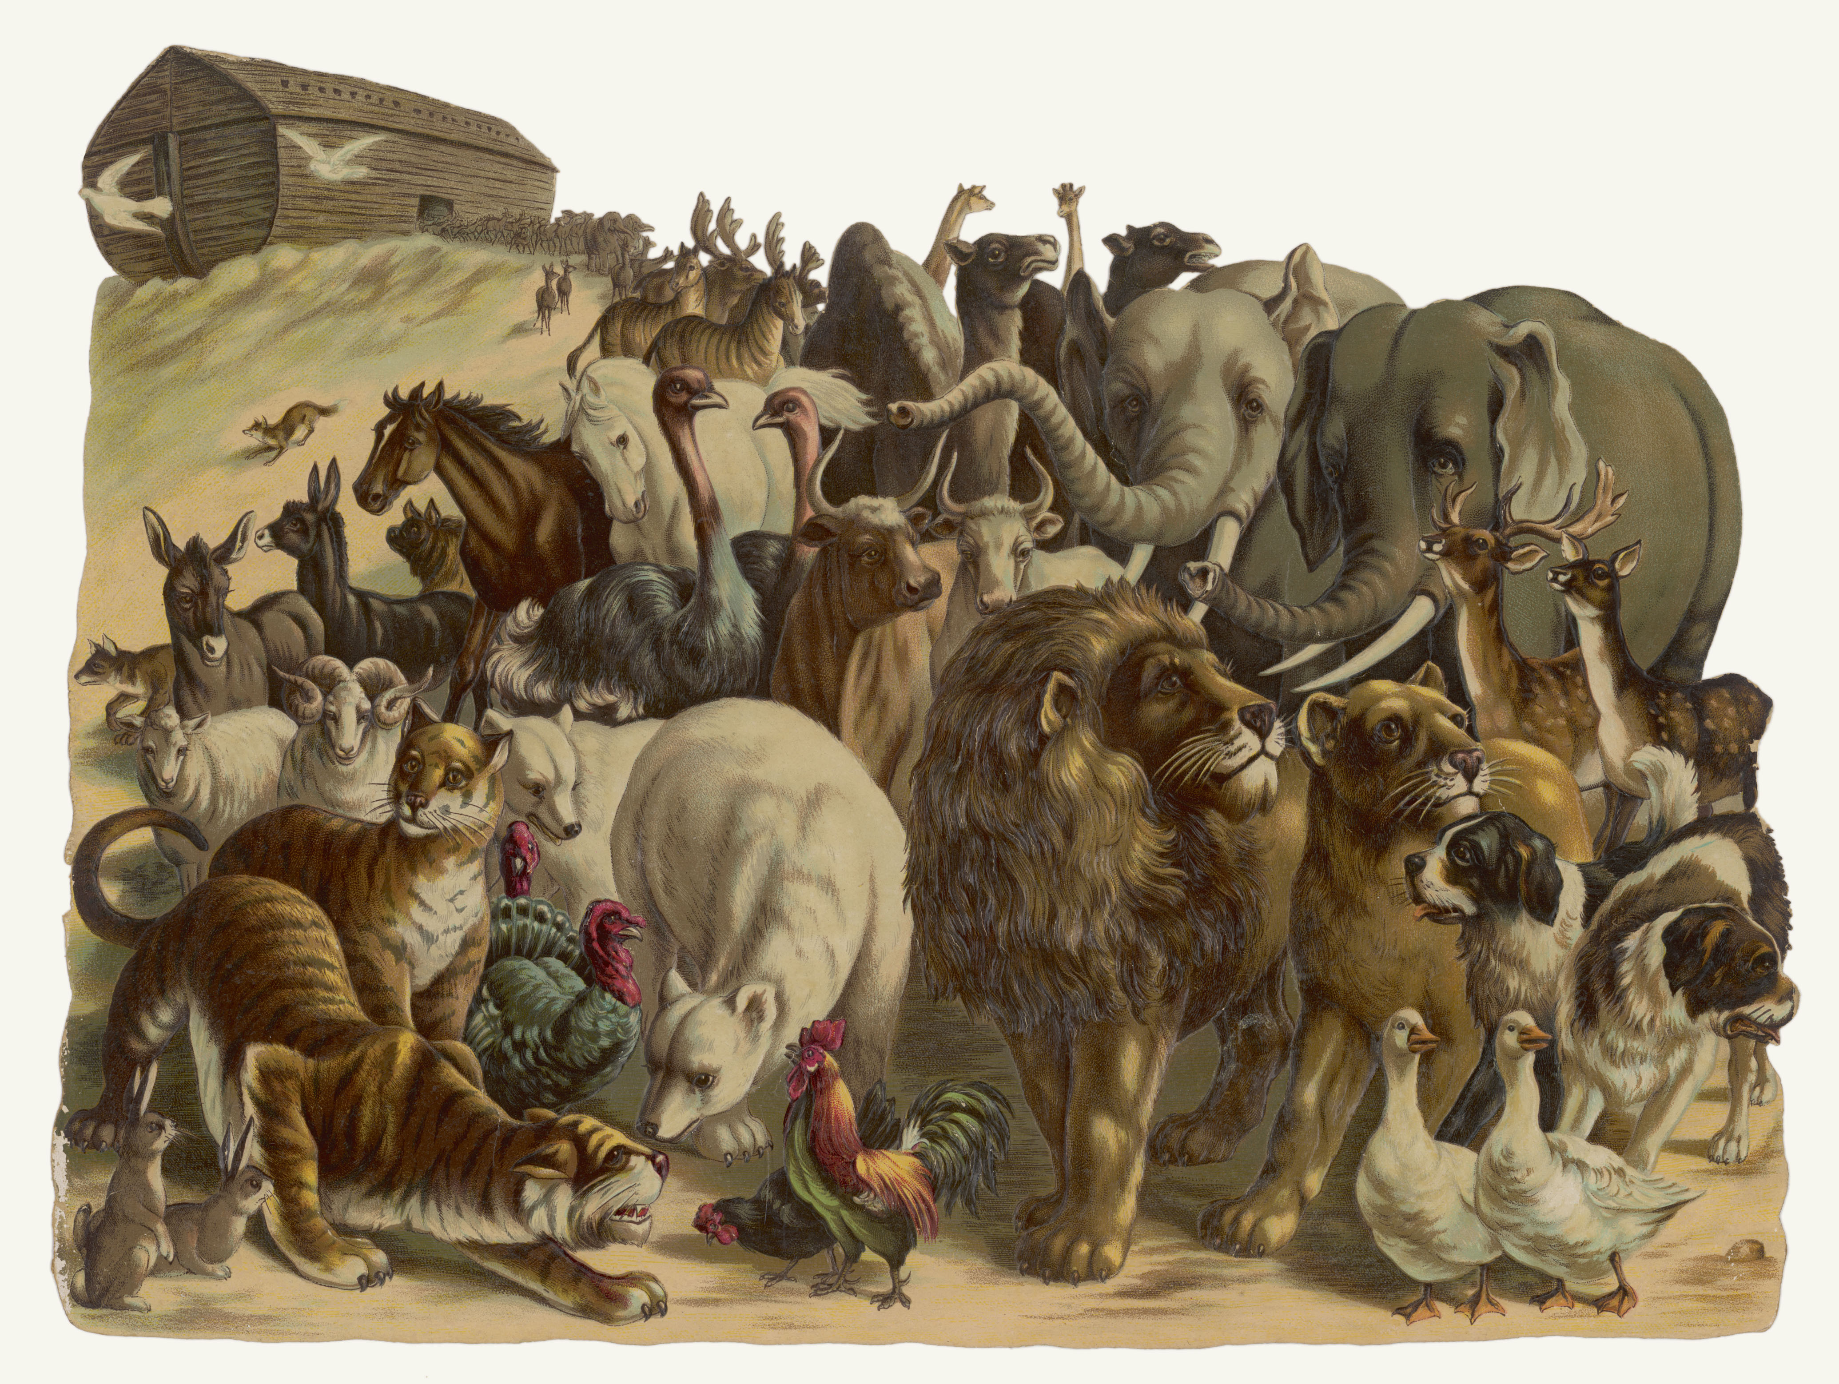
Our Pastor Russell render these verses thus:
"As the days of Noah were, so shall also the presence [Greek parousia] of the Son of Man be. For as in the days that were before the flood they were eating and drinking, marrying and giving in marriage, until the day that Noah entered into the ark, and knew not, … so shall also the presence of the Son of Man be"—
Matt. 24:37-39.

Slide 37
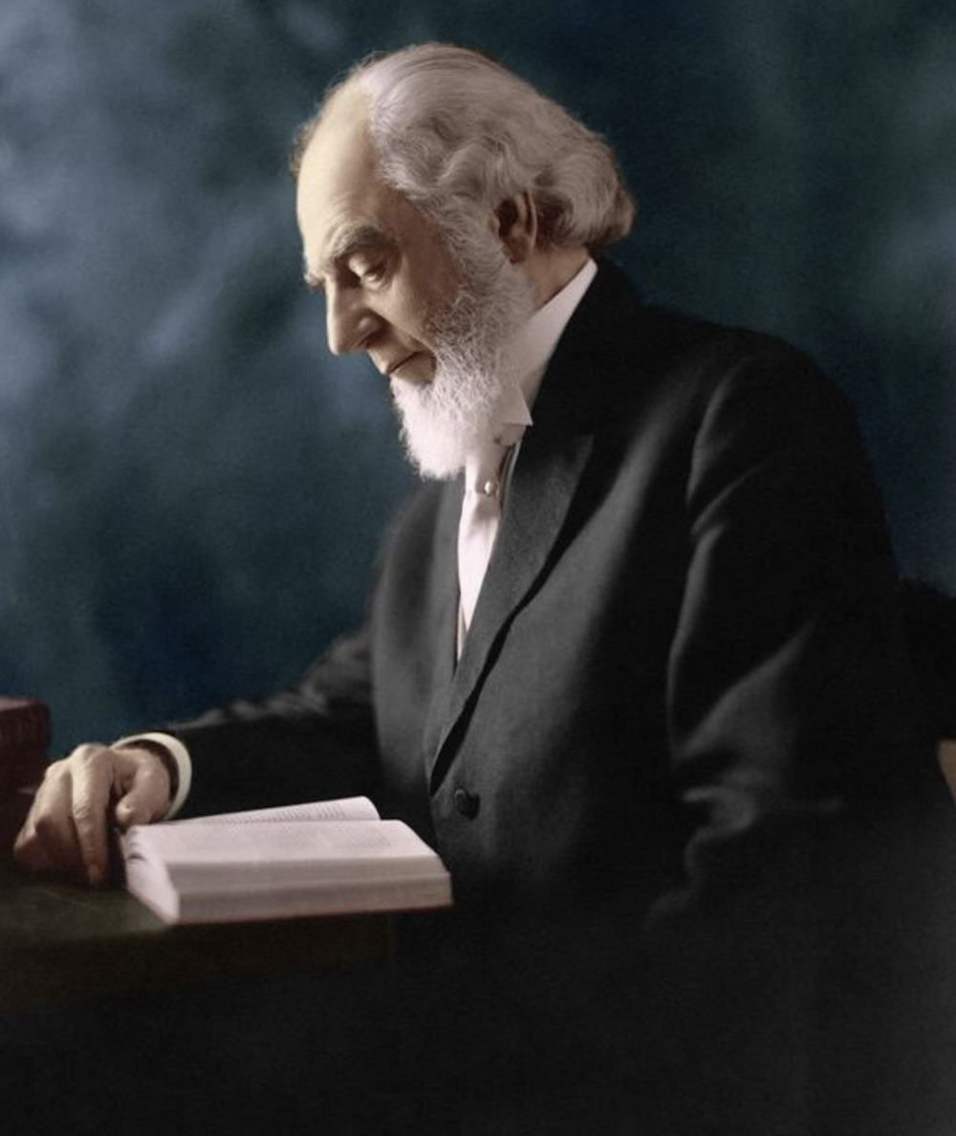
The point of this illustration is overlooked by many who presuppose, without any authority in the Master's words, that the similarity here being pointed out is the wickedness of Noah's day and that of the day of Christ's presence.
But while such a comparison might have been justifiable and proper, the fact remains that such comparison was not made, but avoided. The comparison made is similarity of ignorance.

Slide 38
Only Noah and his family knew; the people knew not, but proceeded as usual, marrying, planting, building, eating and drinking.
Similarly, during the time of Christ's presence in the end of this age, and while the time of trouble is impending, the only ones who will know of his presence or have a clear apprehension of what is coming, or why, or the outcome, will be the Lord's people. Others will know not.
Bro. Charles T Russell
P-4 page 606

Slide 39
The atmospheric conditions of the earth were very different before the flood.
Genesis 2:5, 6
5 for the LORD God had not caused it to rain upon the earth,
6 But there went up a mist from the earth, and watered the whole face of the ground.
So one can see how difficult is would have been for Noah to convince anyone that a flood rain was coming when it had not rained for over 1600 years.

Slide 40
The first rainbow proof of the changed atmosphere
Genesis 9:13, 14, 16
13 I do set my bow in the cloud, and it shall be for a token of a covenant between me and the earth.
14 And it shall come to pass, when I bring a cloud over the earth, that the bow shall be seen in the cloud:
16 And the bow shall be in the cloud; and I will look upon it, that I may remember the everlasting covenant between God and every living creature of all flesh that is upon the earth.

Slide 43
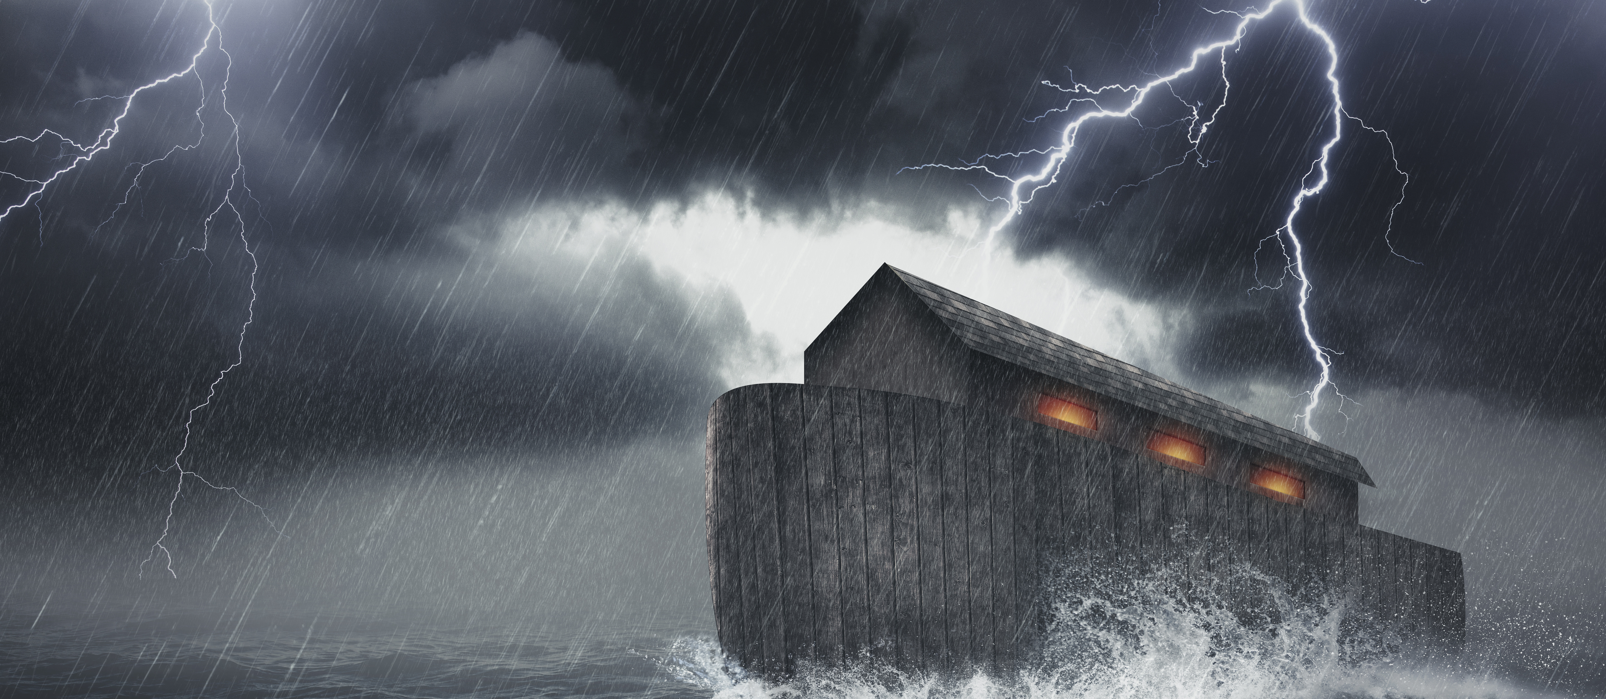

Genesis 6:14-16
14 Make thee an ark of gopher wood; rooms shalt thou make in the ark, and shalt pitch it within and without with pitch.
15 And this is the fashion which thou shalt make it of: The length of the ark shall be three hundred cubits, the breadth of it fifty cubits, and the height of it thirty cubits.
16 You shall make a window for the ark, and finish it to a cubit from the top; and set the door of the ark in the side of it; you shall make it with lower, second, and third decks

Slide 44
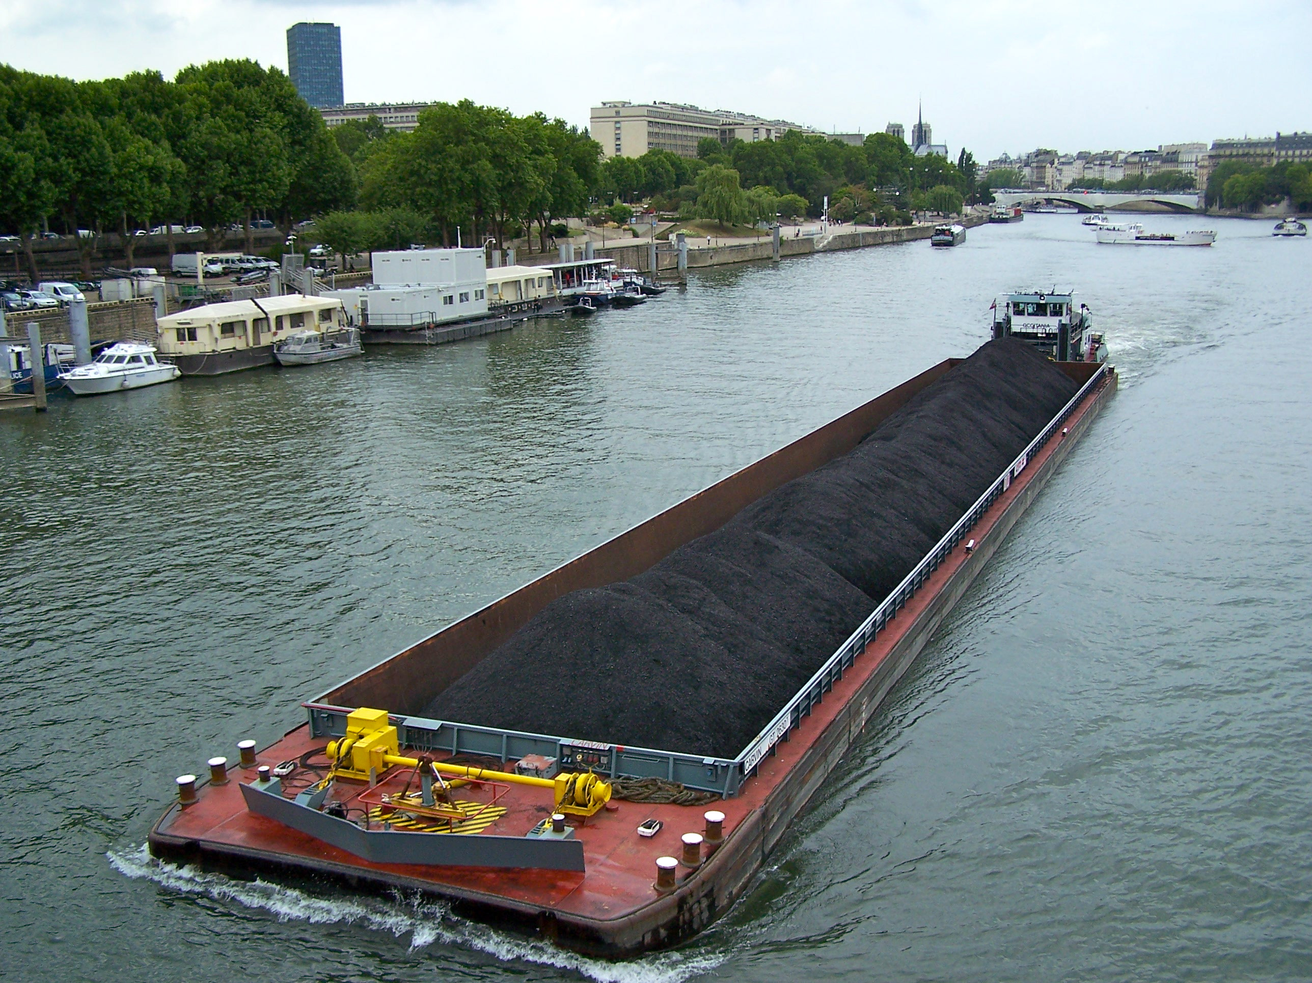
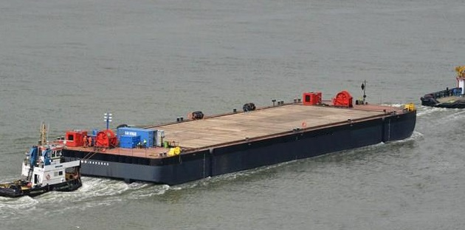

Slide 45
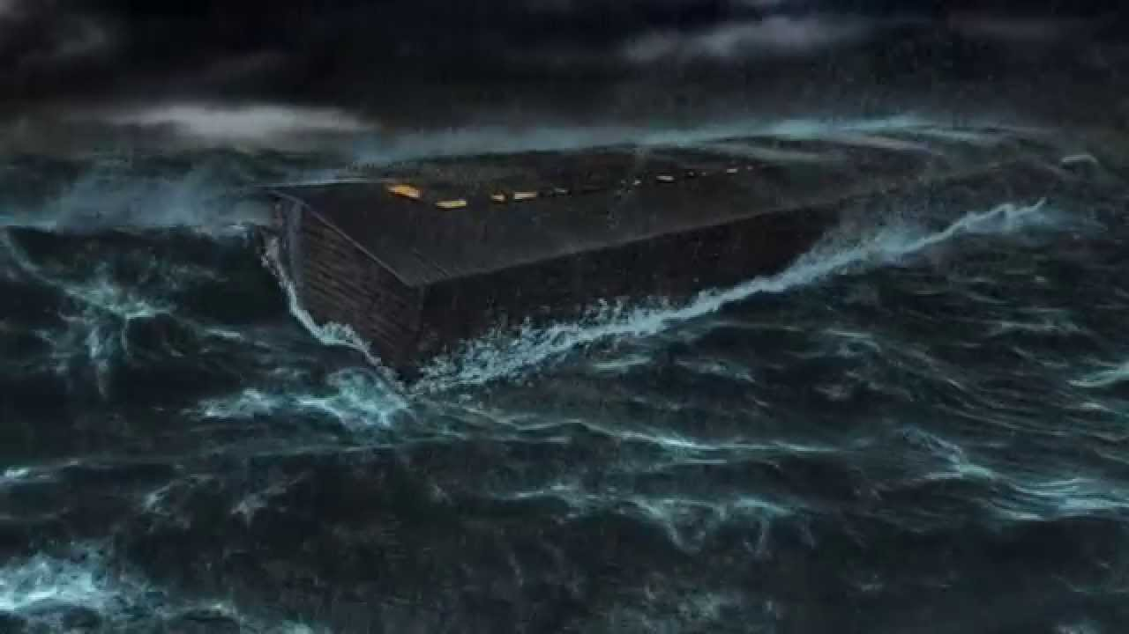

Slide 46
Noah’s Ark
300 x 50 x 30 cubits
3 levels

Slide 47
The dimensions given of the Ark, compared with our large modern ships, are:
The Ark, 300 cubits, 450 ft.; 50 cubits, 75 ft.; 30 cubits, 45 ft.
"Wilhelm der Grosse," 648 " 65 " 45 " "Great Eastern," 680 " 82.5 ft.; 58 "
WT 1907, R3934

Slide 48
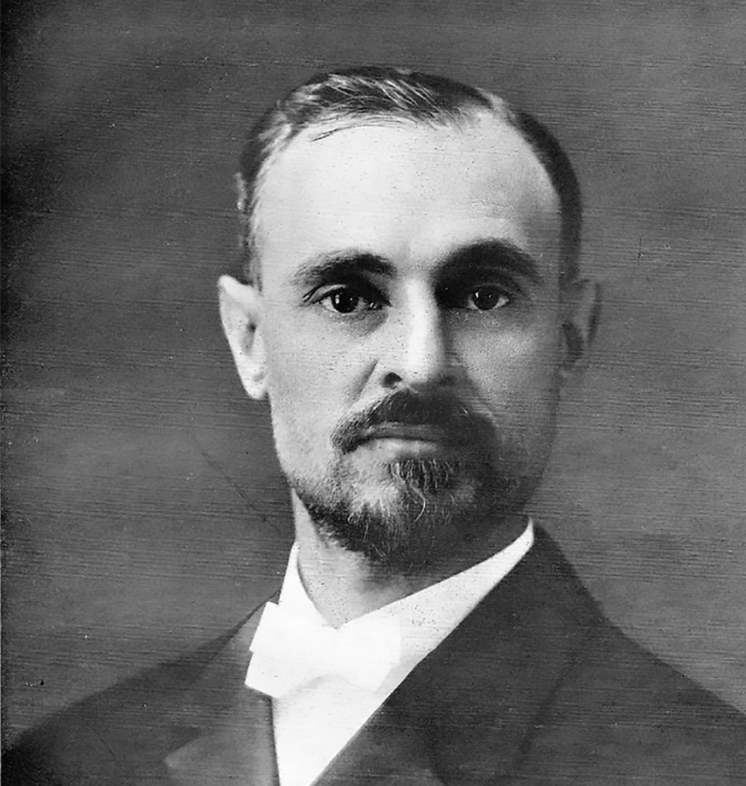
“The sacred cubit was also used in Noah's ark and in Solomon's and Ezekiel's temples, in all of which the cubit of 18 inches breaks down on working out the symbolisms that are later to be given, and in all of which the cubit of 25 inches, the sacred cubit, fits nicely. It is but reasonable that God should, in working out these symbols, have ignored the conflicting cubits of the heathen, and used one adapted to His purposes, which is the sacred cubit, called so because of the uses to which God put it.”
Paul S.L. Johnson
PT 1944 Page 113-C1

Slide 49
The Following scripture seems to prove Bro. Johnsons point that the sacred cubit was the one that God used for his purposes.
2 Chronicles 3:3
These are Solomon's measurements for building the house of God: the length, in cubits of the old standard, was sixty cubits, and the breadth twenty cubits

Slide 50
Brother Johnson also stated in a foot note on page 13 of the book Tabernacle Shadows:
† [The sacred cubit of 25 inches is the cubit of the Tabernacle.]

Slide 51
“Weights and measures may be ranked among the necessaries of life to every individual of human society. They enter into the economical arrangements and daily concerns of every family. They are necessary to every occupation of human industry; to the distribution and security of every species of property; to every transaction of trade and commerce; to the labors of the farmer; to the ingenuity of the skilled tradesman; to the studies of the philosopher; to the researches of the historian; to the navigation of the mariner, and the marches of the soldier; to all the exchanges of peace, and all the operations of war. The knowledge of them, as in established use, is among the first elements of education, and is often learned by those who learn nothing else, not even to read and write. This knowledge is riveted in the memory by the habitual application of it to the employments of men throughout life.”
JOHN QUINCY ADAMS - Report to the US Congress, 1821

Slide 52
Note: brackets ours
“Natural Standards of length such as the hand, span, palm and digit were used from the earliest times, but there is no record of any attempt to establish a permanent standard until the building of the great Khufu Pyramid [we know that this was The Lord’s great pyramid built by Melchizedek] in Egypt about 2900 [2140] B.C. The Pharaoh Khufu was the first to decree that a standard unit of length to be fixed [Melchizedek was probably responsible for this also].
Did this standard work? The answer must be an unequivocal, “yes,” when you consider that no side of the pyramid’s square base deviated from the average side length of 9000 inches by more than 1/20 of 1 percent. Although the history of Egyptians also knew a great deal about measuring angles, since each of the corners of the Great Pyramid is a perfect right angle within 3/1000 of a degree. Achieving this precision is difficult enough today even with all our modern tools and techniques.
Although the Egyptian priests swore by the great Ra to preserve the sacred cubit, they somehow failed because other cubits of different length came into use.
Measurement Science Conference

Slide 53
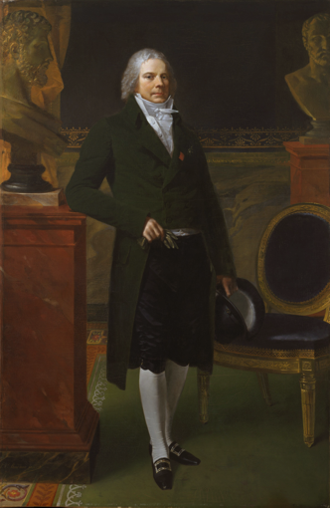
“During the French revolution Prince Talleyrand realizing that unity of weights and standards was one of the keys to national unity, directed the Royal Academy of Science to construct a new system based on the ideas proposed by James Watt, a Scottish inventor and instrument maker, who urged that all scientists to join together in promoting a completely new system of measurement.”
Charles Maurice de Talleyrand-Périgord, 1st Prince de Bénévent 1754-1838

Slide 54
Job 38:4 Where wast thou when I laid the foundations of the earth? declare, if thou hast understanding.
Job 38:5 or who hath stretched the line upon it? Who hath laid the measures thereof, if thou knowest?

Slide 55
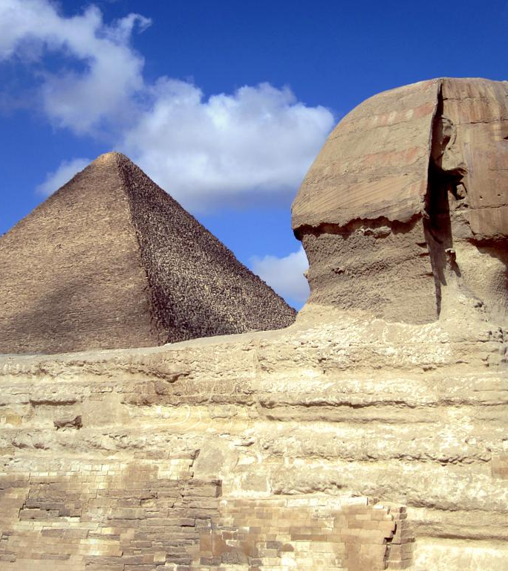
What is a
Sacred Cubit?

Slide 56
When measuring the outside of the Great Pyramid they found many stones were slightly larger than 25 British inches. When they measured the full length of one side of the base in British inches then divided it by 25 they saw that it closely displayed the number of days in a year. They made the corrections and found that the pyramid inch must be 1/1000 larger than the British inch. It also showed that the Pyramid or sacred cubit must be 25 cubit inches. After the corrections were made the length of one side displayed the exact number of days in a year.

Slide 57
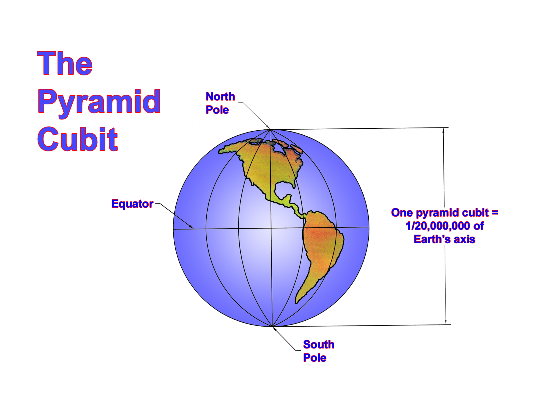

Slide 58
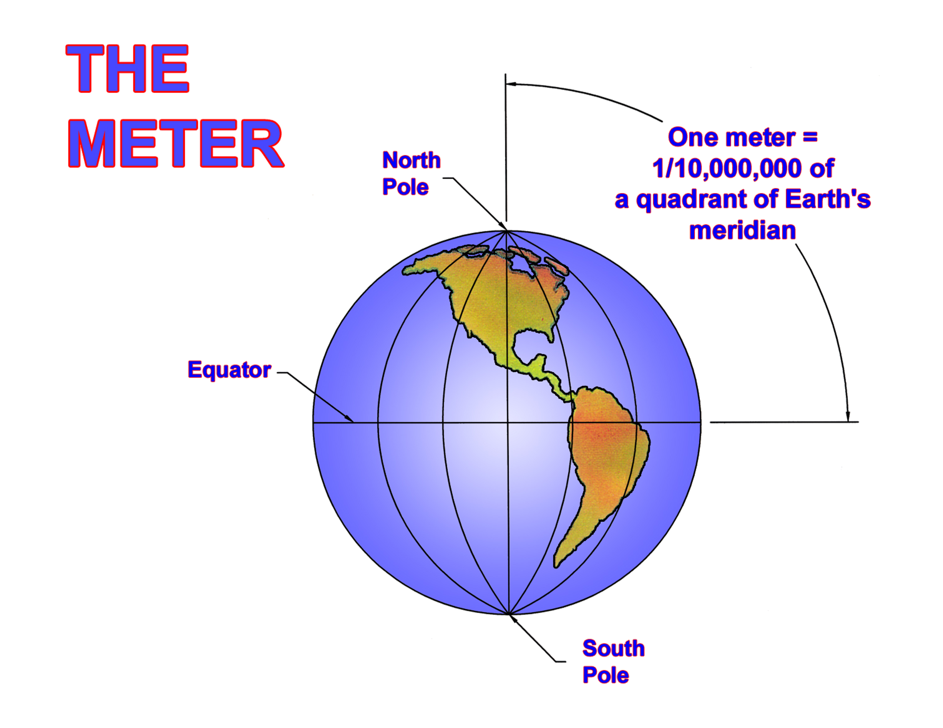

Slide 59
Noah’s Ark
300 L x 50 W x 30 H cubits

Slide 60
Noah’s Ark
190.5 L x 31.75 W x 19.05 H meters

Slide 61
Noah’s Ark
625.625 L x 104.27 W x 62.53 H feet

Slide 62
The key numbers in the construction and contents of Noah’s Ark are:
300 - length
50 - width
30 - height
3 - levels
12 - edges
8 - corners
6 - sides
4 - couples or spiritual groups
7 - clean animals
7 - birds
2 - unclean animals
10 – highest divisible factor of the dimensions

Slide 63
300 - length
50 - width
30 - height
3 - levels
12 - edges
8 - corners
6 - sides
4 - couples or spiritual groups
7 - clean animals
7 - birds
2 - unclean animals
10 – highest divisible factor of the dimensions
The sum of the edges on one side = 30+30+300+300=660 or
(2x30)+(2x300)=660
There are 6 outer surfaces. 6x660=3960
3960 years;—from the Abrahamic Covenant, 2045 B.C., to the end of Passover 1916, when all the Elect were sealed.
See Genesis 15:7-21
PT 1919 Page 69-C1
PT 1924 Page 161-C2
PT 1971 Page 68-C2

Slide 64
300 - length
50 - width
30 - height
3 - levels
12 - edges
8 - corners
6 - sides
4 - couples or spiritual groups
7 - clean animals
7 - birds
2 - unclean animals
10 – highest divisible factor of the Ark’s dimensions
(4 x 300) + (2 x 30) x 2 = 2520
7 x 360 = 2520
From the end of Adam’s day 3126 B.C. to when Israel is overthrown 606 B.C., called the "Seven Times"

Slide 65
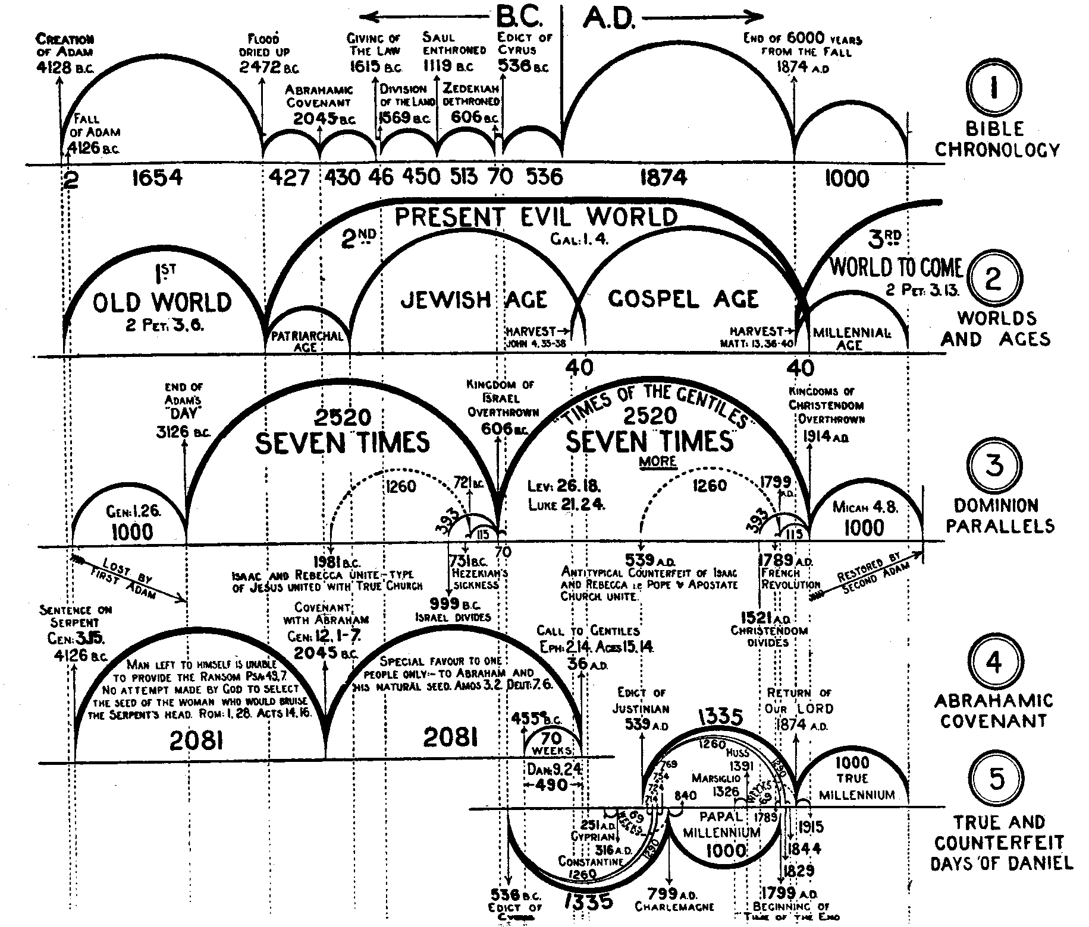

Slide 66
300 - length
50 - width
30 - height
3 - levels
12 - edges
8 - corners
6 - sides
4 - couples or spiritual groups
7 - clean animals
7 - birds
2 - unclean animals
10 – highest divisible factor of the Ark’s dimensions
(4 x 300) + (2 x 30) x 2 = 2520
7 x 360 = 2520
From 606 B.C. when Israel is overthrown to 1914 A.D. when the time of trouble starts on Christendom called the "Seven Times More".
Lev. 26:18, 21, 24, 28

Slide 68
300 - length
50 - width
30 - height
3 - levels
12 - edges
8 - corners
6 - sides
4 - couples or spiritual groups
7 - clean animals
7 - birds
2 - unclean animals
10 – highest divisible factor of the dimensions
(4 x 300) + (2 x 30) = 1260 From 1981 B.C. when Isaac and Rebecca unite “type of Jesus uniting with the Church” until 721 B.C.
(10 years after Hezekiah's sickness).

Slide 70
300 - length
50 - width
30 - height
3 - levels
12 - edges
8 - corners
6 - sides
4 - couples or spiritual groups
7 - clean animals
7 - birds
2 - unclean animals
10 – highest divisible factor of the dimensions
(4 x 300) + (2 x 30) = 1260 From 539 A.D., when the antitypical counterfeit of Isaac and Rebecca, the pope and the apostate church, unite, until 1799 A.D.
The times times and half a times of Dan. 7:25 and Dan. 12:7.

Slide 72
1260-260=1000 (Second Adam’s day)
Micah 4:8

Slide 74
1260-260=1000 (Adam's Day)
Genesis 1:26

Slide 76
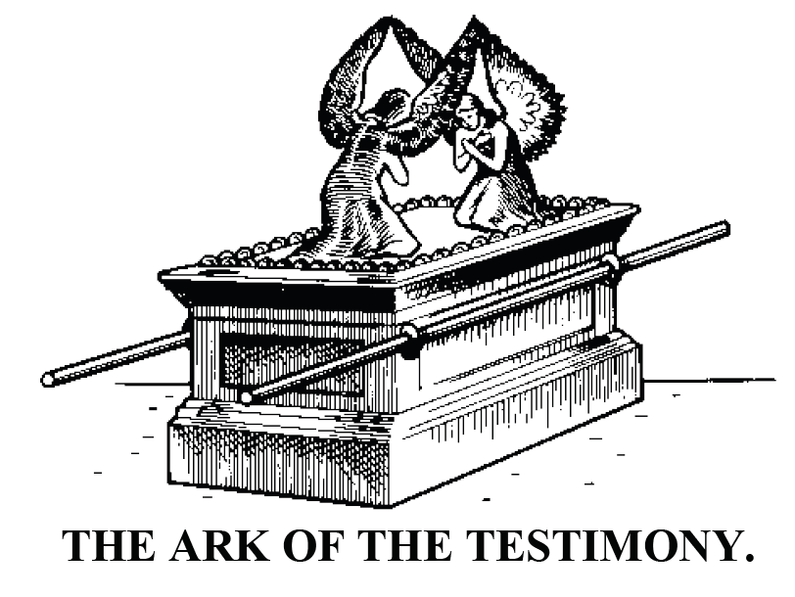
Ark of the Covenant
2 1/2 x 1 1/2 x 1 1/2 cubits
Exodus 25:10; 37:1
ALSO KNOWN AS
THE ARK OF THE COVENANT.

Slide 77
Ark of the Covenant = 2 1/2 x 1 1/2 x 1 1/2 cubits
Exodus 25:10; 37:1
Exactly 80,000 fit into the Arc

Slide 78
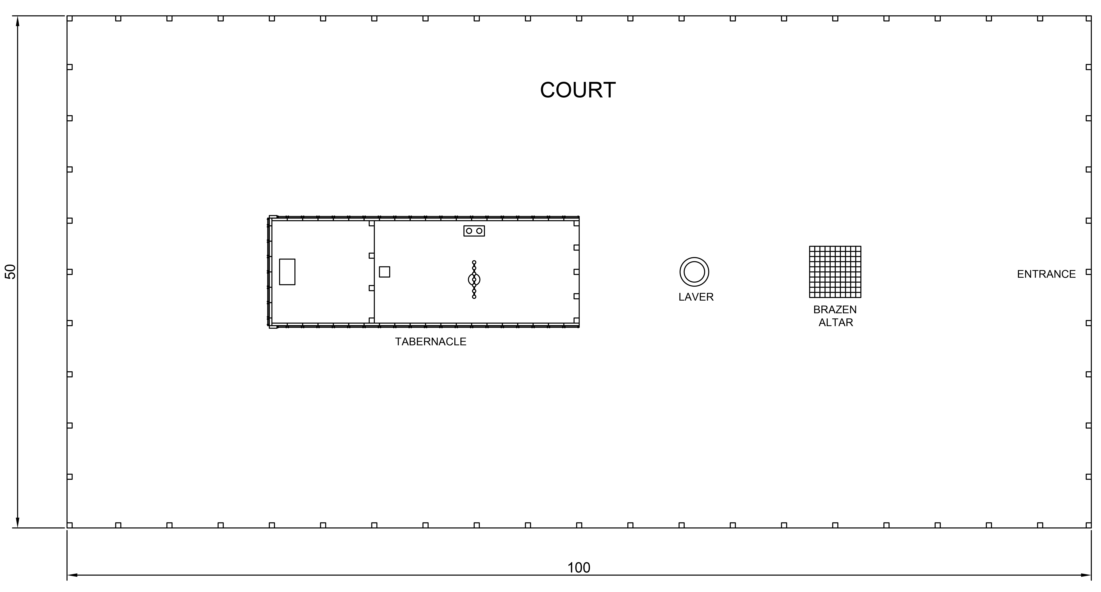

Slide 79
Court = 100 x 50 x 5 cubits
Exodus 27:18
exactly 18 fit into the Ark

Slide 80
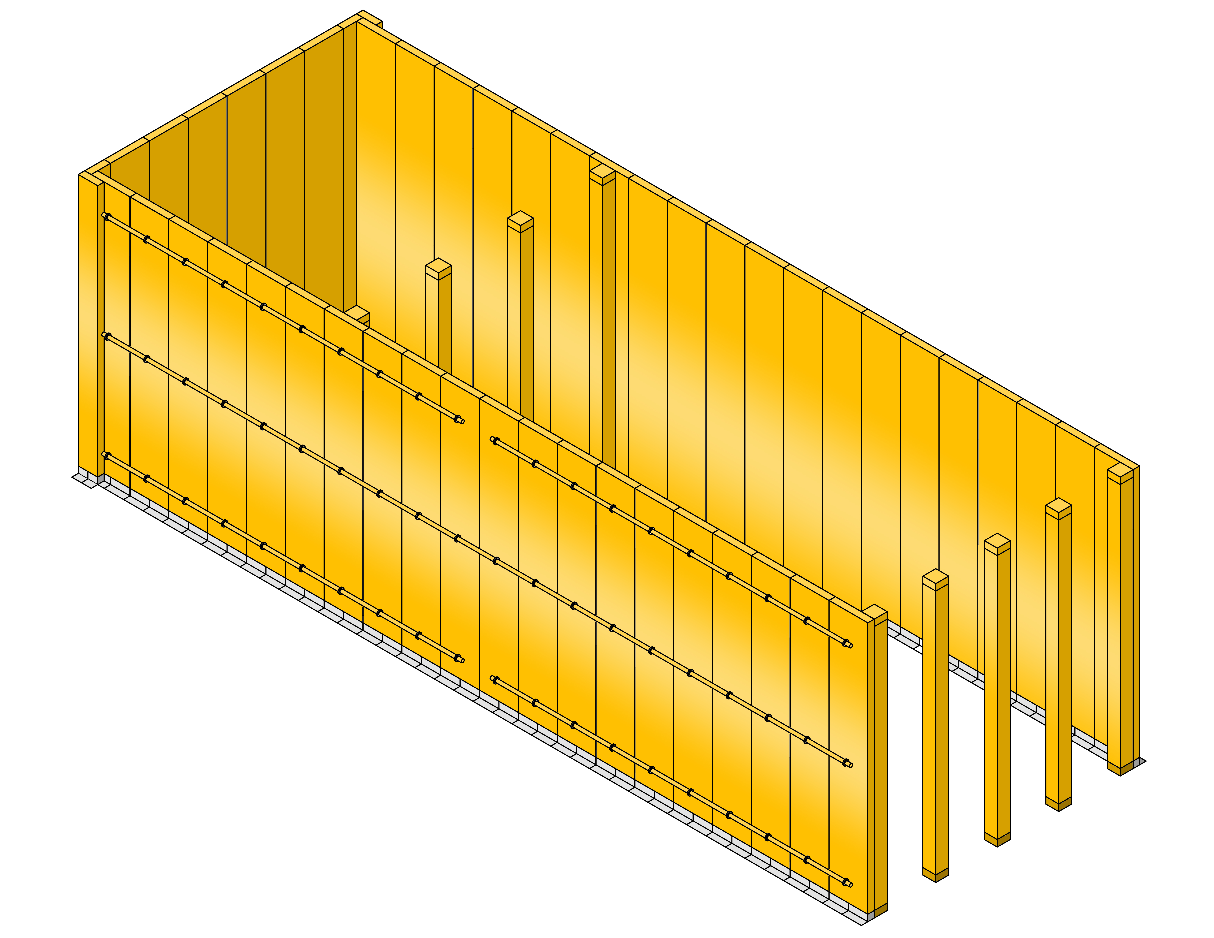

Slide 81
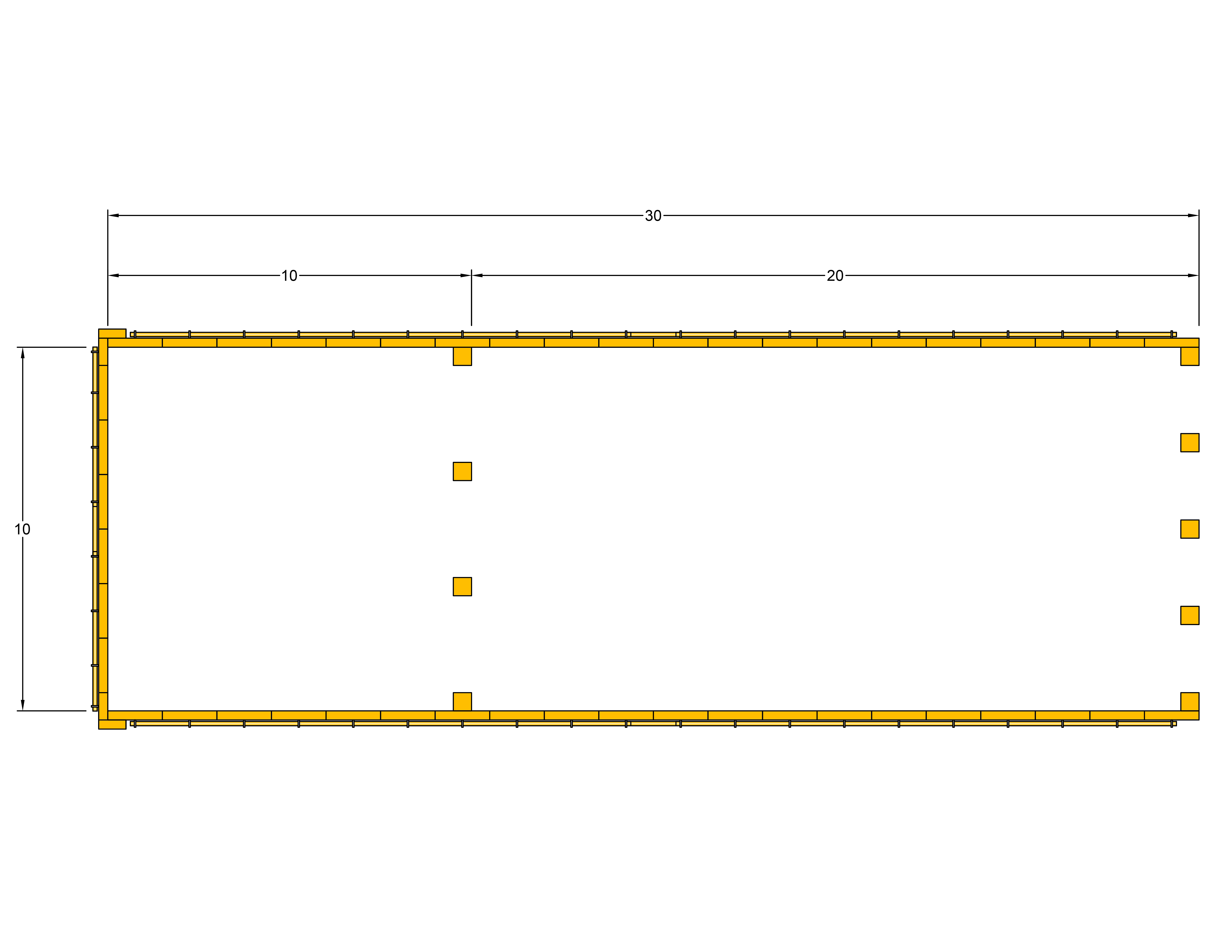

Slide 82
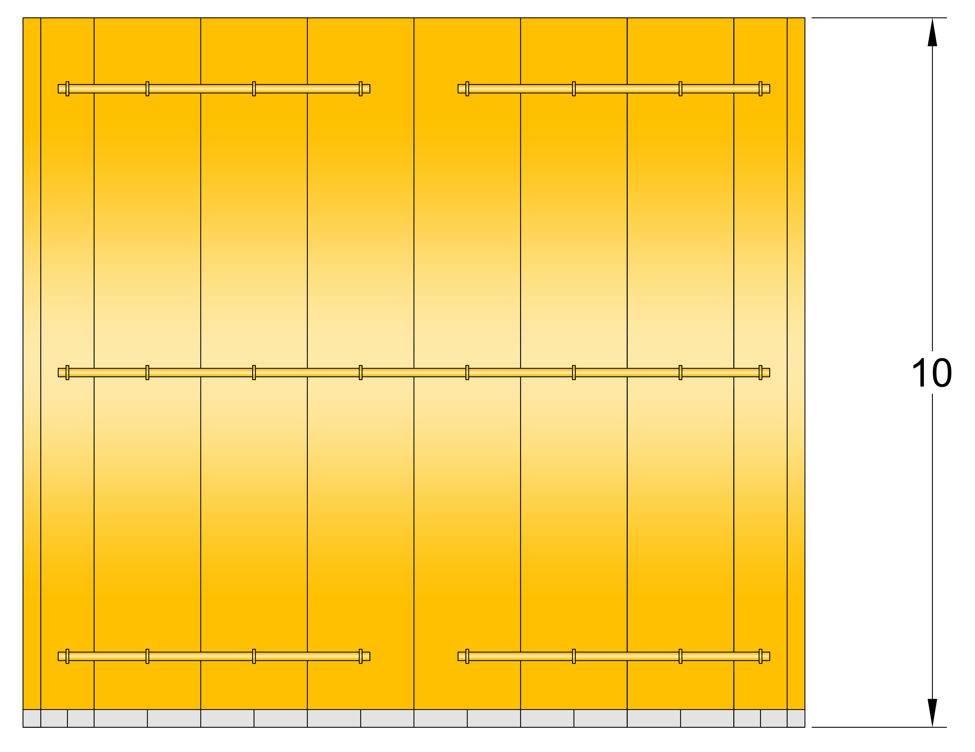

Slide 83
Tabernacle = 30 x 10 x 10 cubits
Exodus 26:15-25
See: Tabernacle Shadows Pages 12, 13
Exactly 150 fit into the Ark

Slide 86
The Holy = 10 x 10 x 10 cubits
Exodus 26:15-25
See: Tabernacle Shadows Pages 12, 13
Exactly 450 fit into the Ark

Slide 87
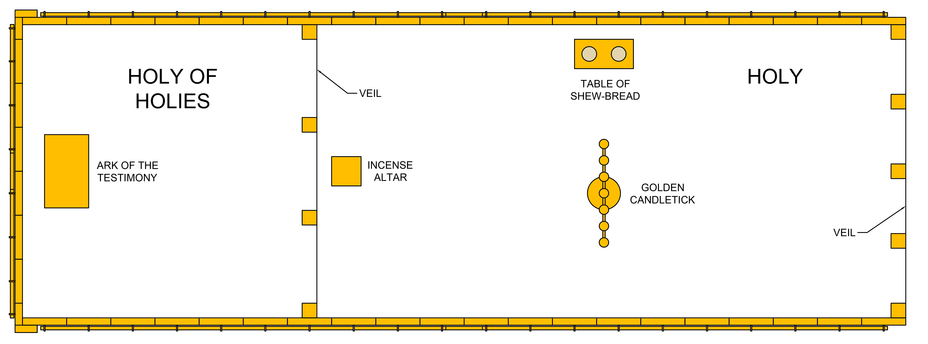

Slide 88
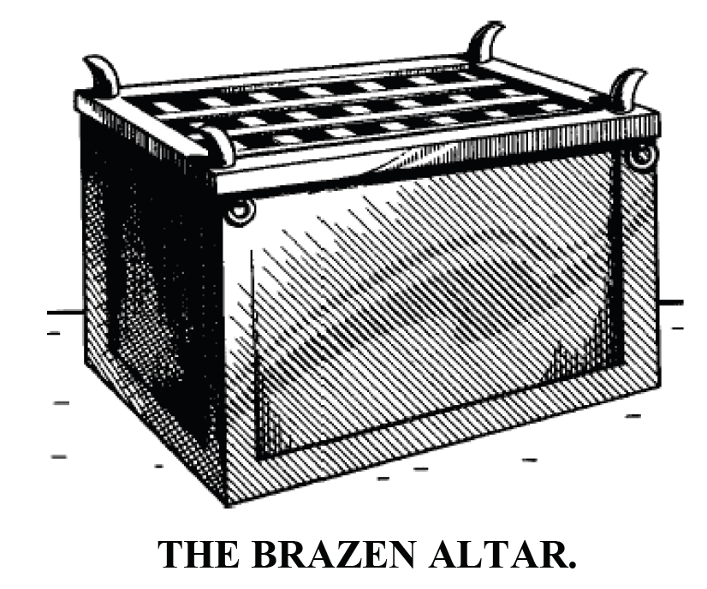
Brazen Altar
5 x 5 x 3 cubits
Exodus 27:1; 38:1

Slide 89
Brazen Altar = 5 x 5 x 3 cubits
Exodus 27:1; 38:1
Exactly 6000 fit into the Ark

Slide 90
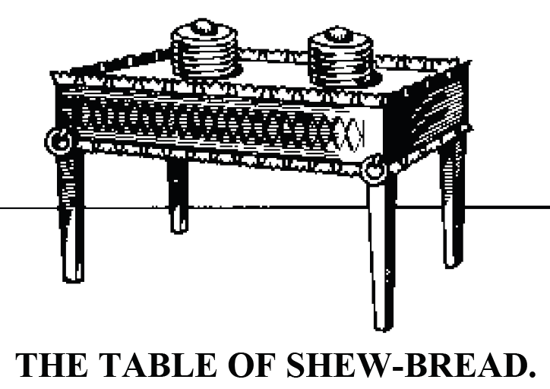
Table of the Shew Bread
2 x 1 x 1 1/2 cubits
Exodus 25:23; 37:10

Slide 91
Table of the Shew Bread= 2 x 1 x 1 1/2 cubits
Exodus 25:23; 37:10
Exactly 150,000 fit into the Arc

Slide 92
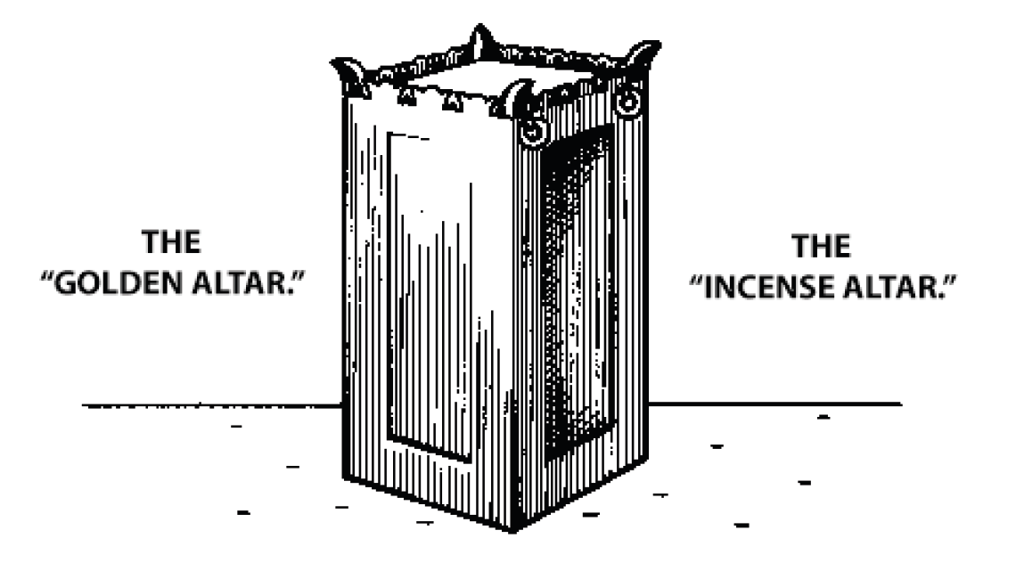
Incense or Golden Alter 1 x 1 x 2 cubits
Exodus 37: 25

Slide 93
300 - length
50 - width
30 - height
3 - levels
12 - edges
8 - corners
6 - sides
4 - couples or spiritual groups
7 - clean animals
7 - birds
2 - unclean animals
10 – highest divisible factor of the Ark’s dimensions
Incense or Golden Alter = 1 x 1 x 2 cubits
Exodus 37: 25
Exactly 225,000 fit into the Ark

Slide 94
4 X 30 = 120
4 X 300 = 1200
120 X 1200 = 144,000
Or
4 x 30 x 4 x 300 = 144,000

Slide 95
Sides 9000 sq. cubits each
Top & Bottom 15000 sq. cubits each
(9000 x 2) + (15,000 x 2) = 48,000
48,000 x 3 levels = 144,000

Slide 96
300 - length
50 - width
30 - height
3 - levels
12 - edges
8 - corners
6 - sides
4 - couples or spiritual groups
7 - clean animals
7 - birds
2 - unclean animals
10 – highest divisible factor of the Ark’s dimensions
exactly 18 fit into the Ark
18 x 50 x 10 x 8 x 2 = 144000

Slide 97
300 - length
50 - width
30 - height
3 - levels
12 - edges
8 - corners
6 - sides
4 - couples or spiritual groups
7 - clean animals
7 - birds
2 - unclean animals
10 – highest divisible factor of the Ark’s dimensions
Exactly 150 fit into the Ark
150 x 12 x 10 x 8 = 144000

Slide 98
300 - length
50 - width
30 - height
3 - levels
12 - edges
8 - corners
6 - sides
4 - couples or spiritual groups
7 - clean animals
7 - birds
2 - unclean animals
10 – highest divisible factor of the Ark’s dimensions
Exactly 450 fit into the Ark
450 x 10 x 8 x 4 =144,000

Slide 99
300 - length
50 - width
30 - height
3 - levels
12 - edges
8 - corners
6 - sides
4 - couples or spiritual groups
7 - clean animals
7 - birds
2 - unclean animals
10 – highest divisible factor of the Ark’s dimensions
Exactly 6000 fit into the Ark
6000 x 8 x 3 = 144000

Slide 100
300 - length
50 - width
30 - height
3 - levels
12 - edges
8 - corners
6 - sides
4 - couples or spiritual groups
7 - clean animals
7 - birds
2 - unclean animals
10 – highest divisible factor of the Ark’s dimensions
Exactly 80,000 fit into the Arc
80,000 x 3 x 12 ÷ 2 ÷ 10 = 144,000

Slide 101
300 - length
50 - width
30 - height
3 - levels
12 - edges
8 - corners
6 - sides
4 - couples or spiritual groups
7 - clean animals
7 - birds
2 - unclean animals
10 – highest divisible factor of the Ark’s dimensions
Exactly 150,000 fit into the Arc
150,000 ÷ 300 x 3 x 8 x 12=144,000

Slide 102
300 - length
50 - width
30 - height
3 - levels
12 - edges
8 - corners
6 - sides
4 - couples or spiritual groups
7 - clean animals
7 - birds
2 - unclean animals
10 – highest divisible factor of the Ark’s dimensions
Exactly 225,000 fit into the Ark
225000 ÷ 50 x 4 x 8 = 144,000

Slide 103

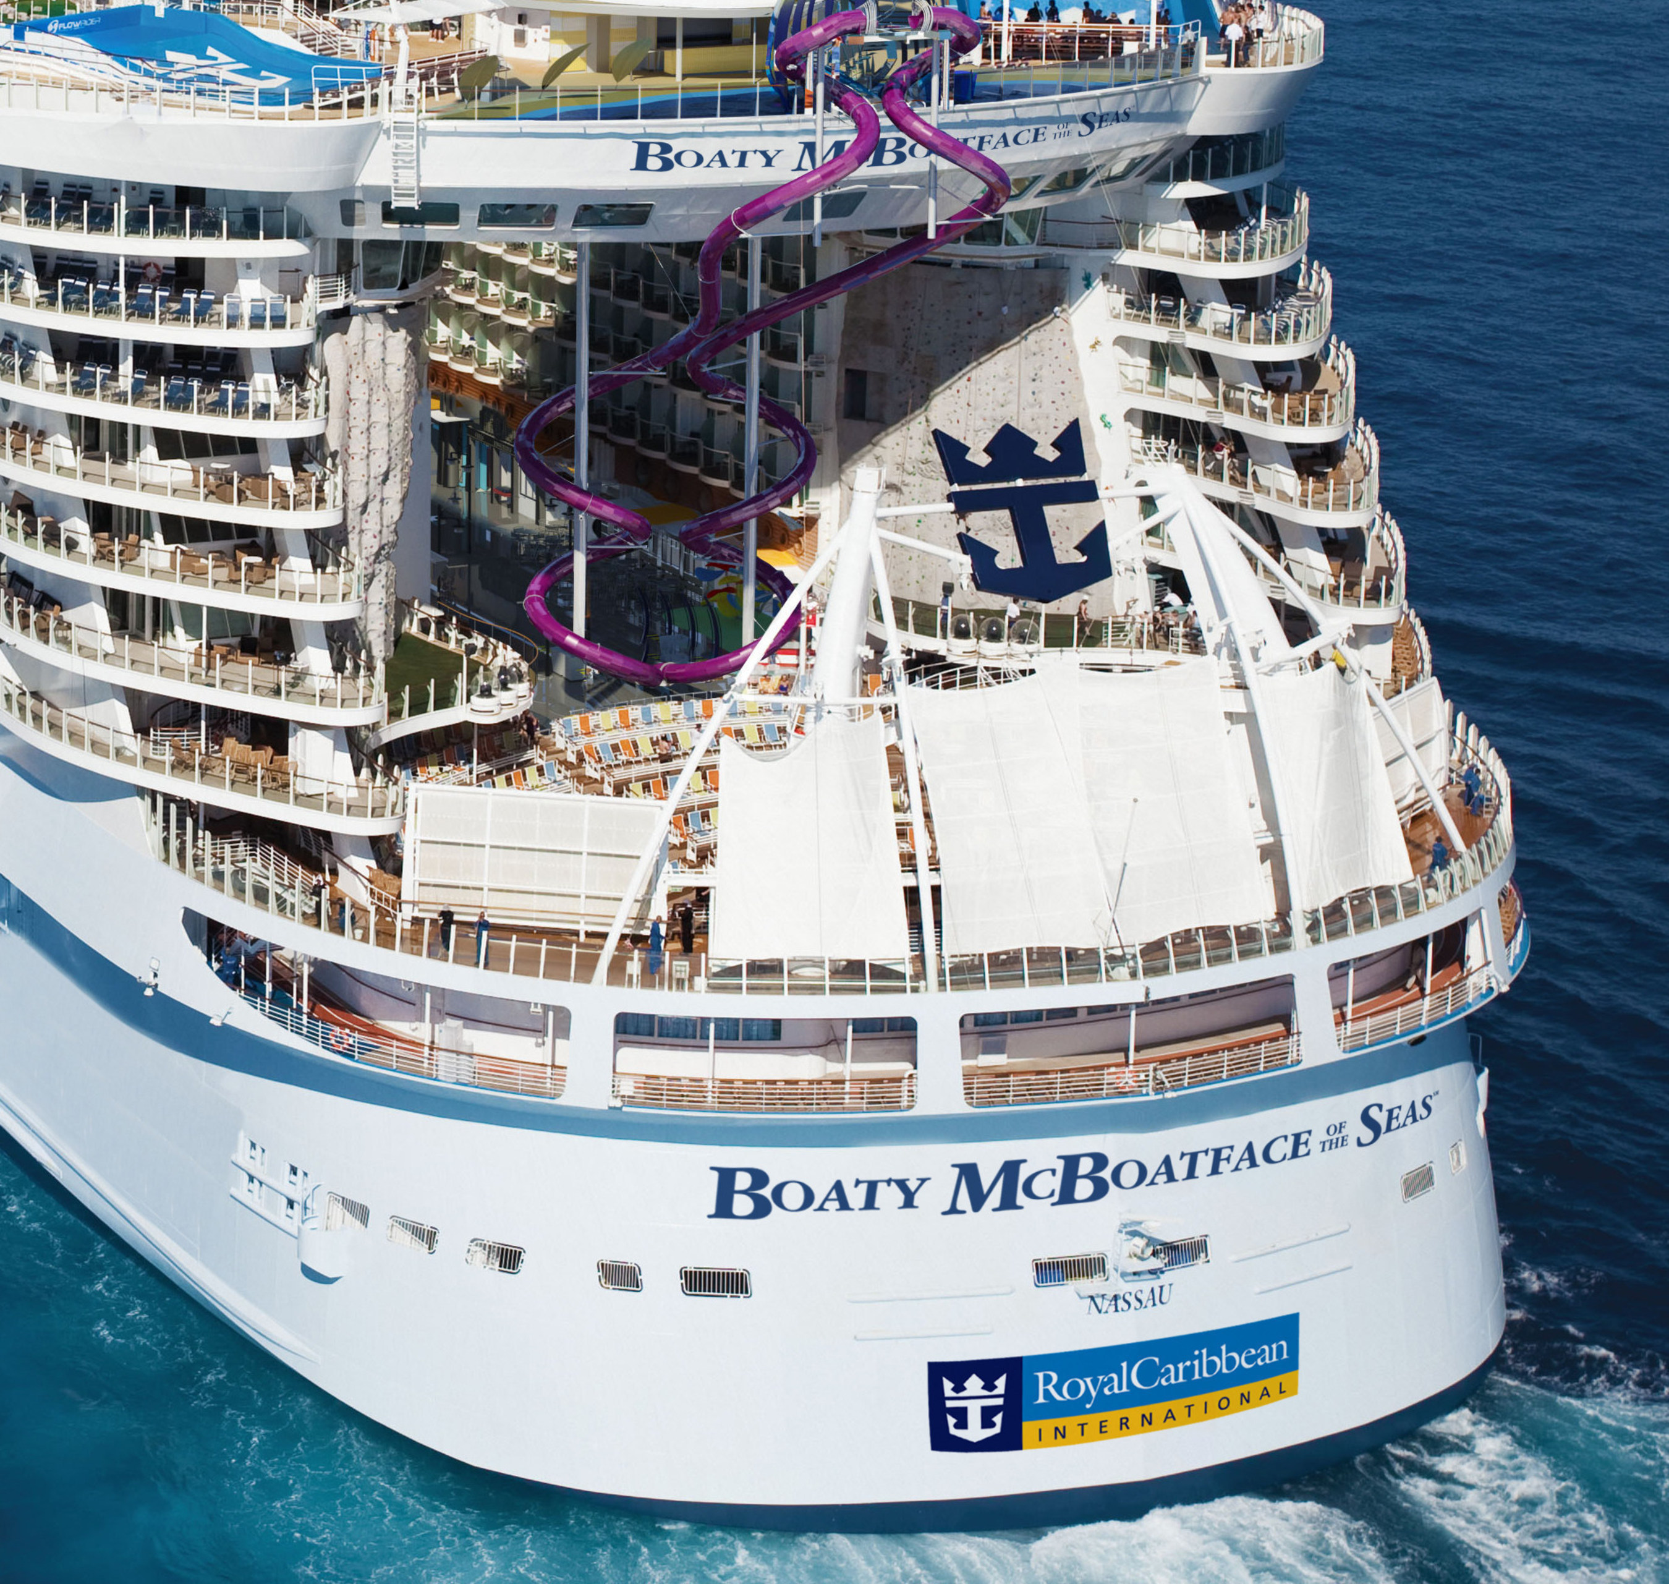

Slide 104
The product of these letters (J H V H) the Hebrew form of
Jehovah:
J = 10 H = 5 V = 6
10 X 5 X 6 X 5 = 1500
Width x height of each end:
30 x 50 = 1500

Slide 105
The product of these letters (J H V H) the Hebrew form of
Jehovah:
J = 10 H = 5 V = 6
10 X 5 X 6 X 5 = 1500
Width x height of each end:
30 x 50 = 1500

Slide 106
Noah’s Ark
Interesting Facts
END

